Slide 1
BRITISH AIRLINES
CUSTOMER BOOKINGS – KEY INSIGHTS

Slide 2
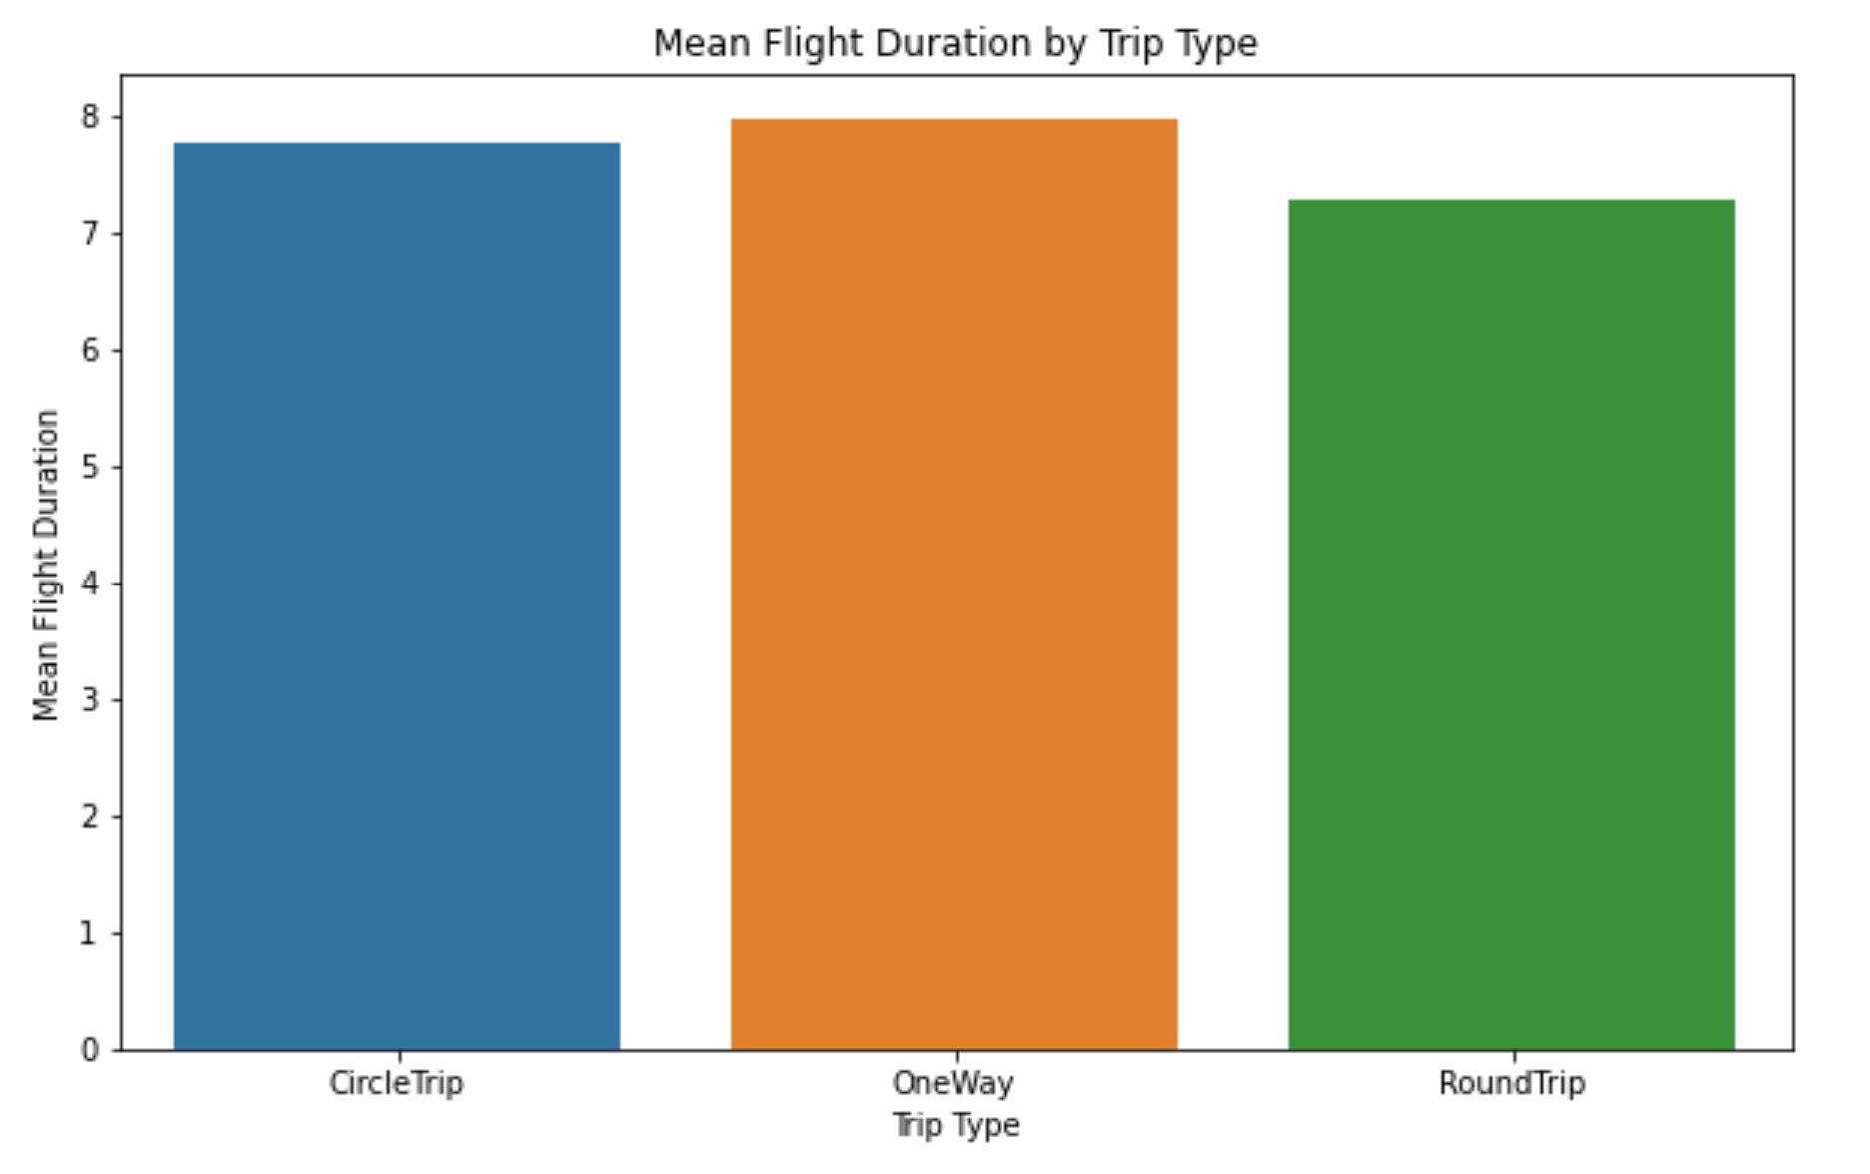
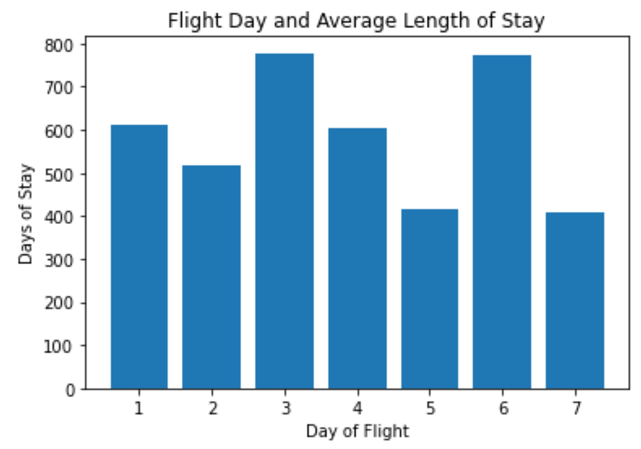
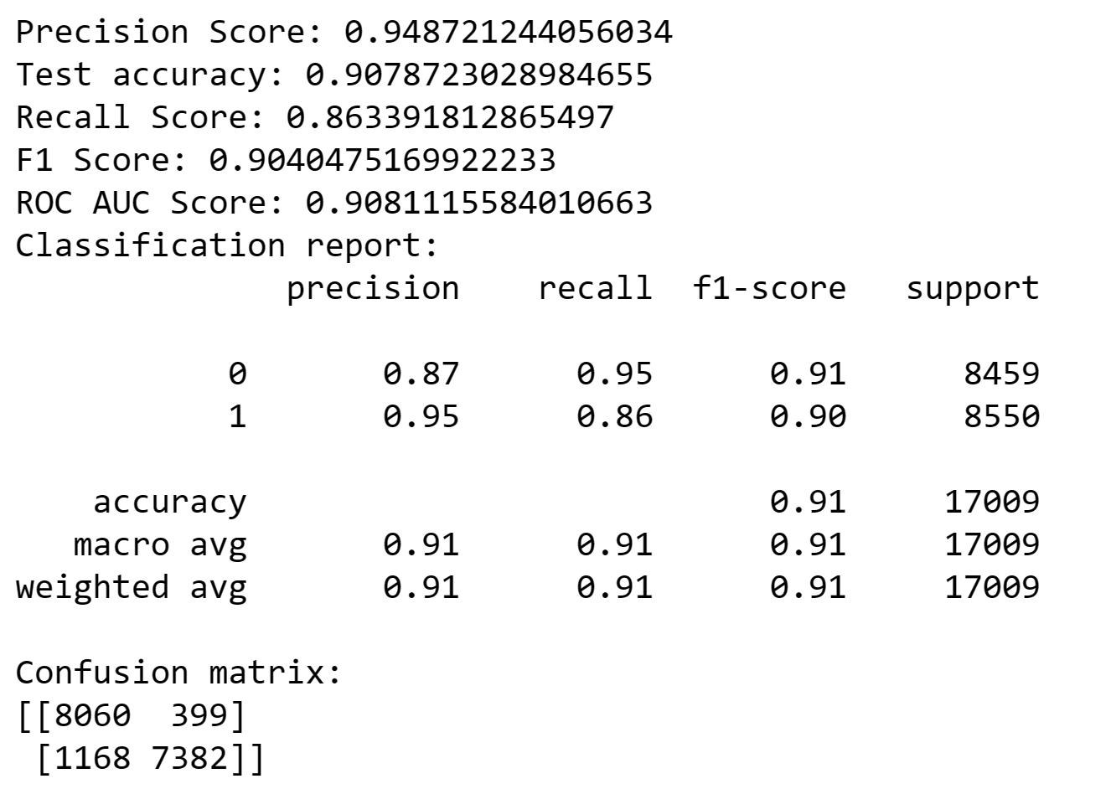
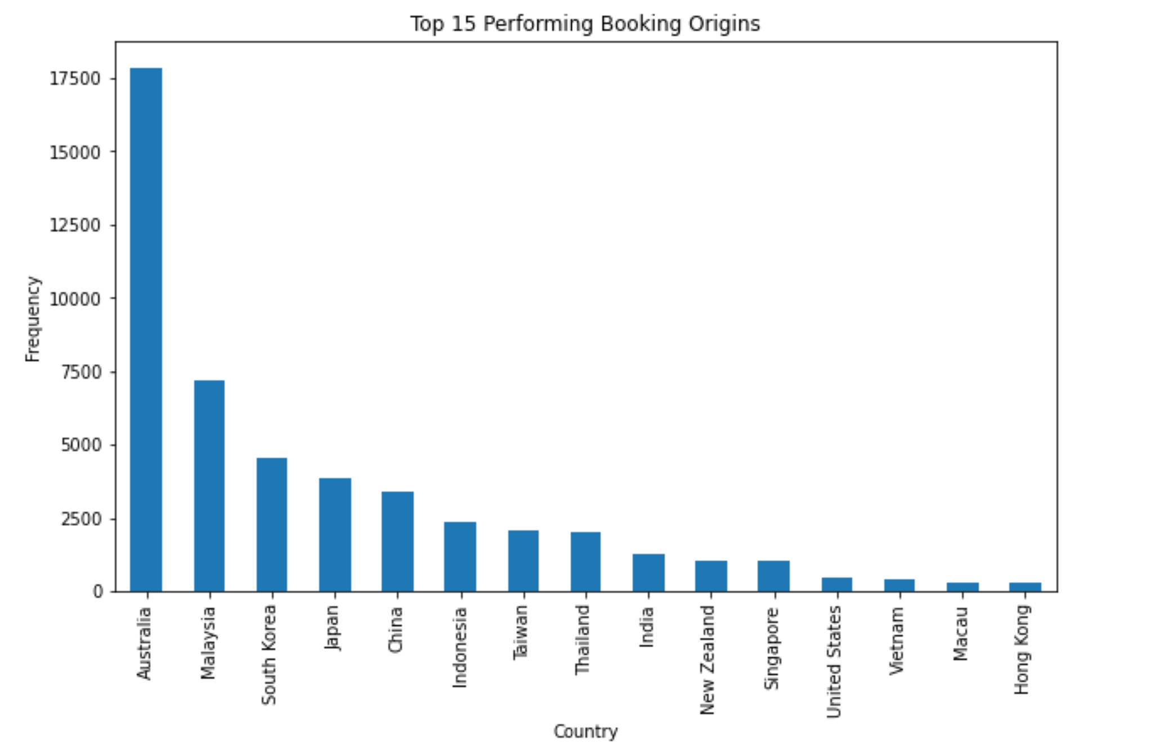
The Random Forest Classifier with SMOTE model has performed well and the results are as follows:

Slide 3
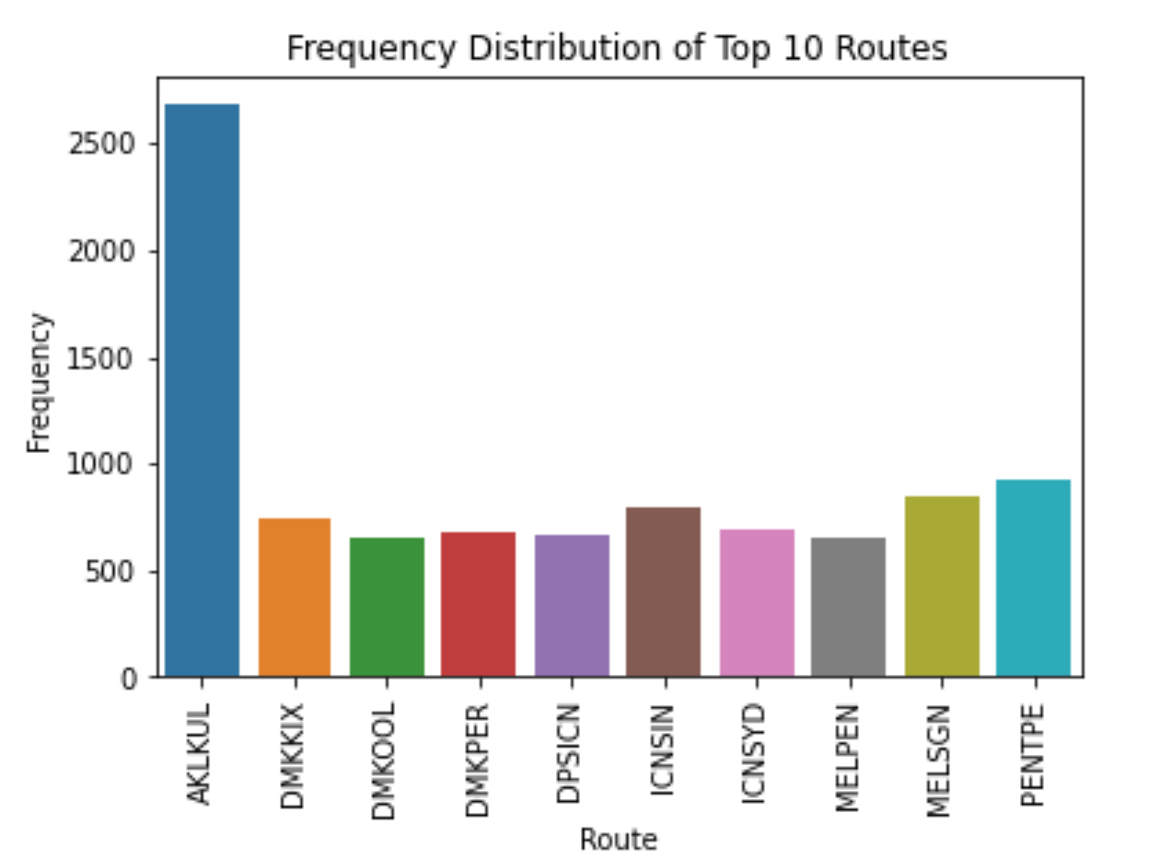
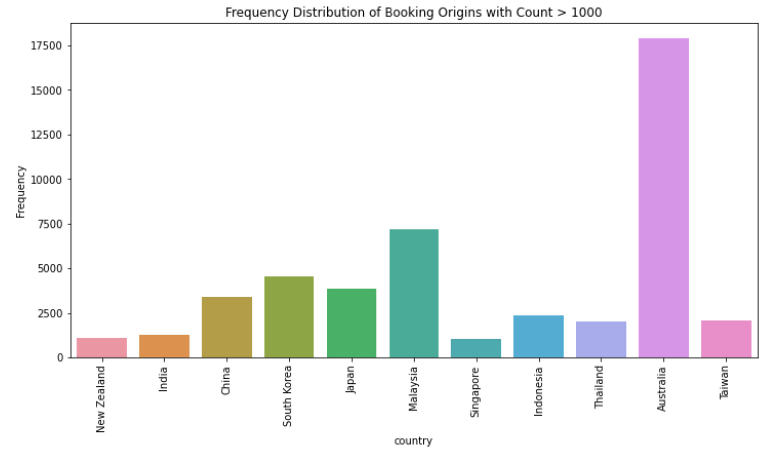
Summary
The average length of stay is on Saturday → Weekends; Wednesday → Weekdays.
AUSTRALIA is the highest booking origin, followed by Malaysia and South Korea.
ONE-WAY trip type has more booking than Circle trip & Round Trip.

